Slide 1

Online Shopping Website [Shoppers]

Slide 2

SUBMITED BY : MUBASHIR P

Slide 3
INTRODUCTION
E-commerce (electronic commerce) is the activity of electronically buying or selling of products on online services or over the Internet.

Slide 4

MODULES
Visitor Side- See the products
Customer Side- Buy a product
Admin Side- Add, Update and Remove a product

Slide 5
PURPOSE
The Online Shopping System (Shoppers) shop web application is intended to provide complete solutions for vendors as well as customers through a single get way using the internet. It will enable vendors to setup online shops, customer to browse through the shop and purchase them online without having to visit the shop physically. The administration module will enable a system administrator to approve and reject requests for new shops and maintain various lists of shop category.

Slide 6

Project Scope
This system allows the customers to maintain their cart for add or remove the product over the internet.

Slide 7


Used Tools & Technologies

Slide 8

Front End Technology

Slide 9

Back End Technology

Slide 10


DataBase
OR

Slide 11
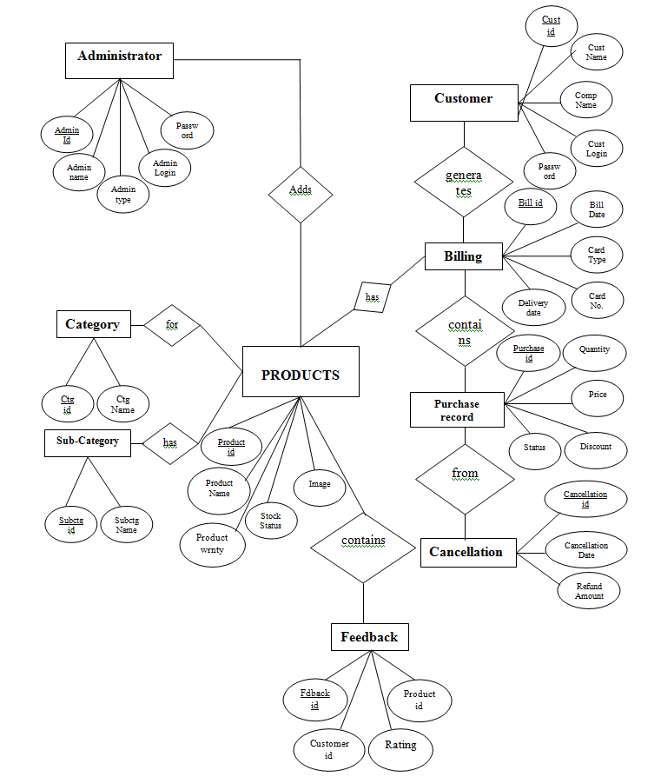
Data Flow Diagram

Slide 12
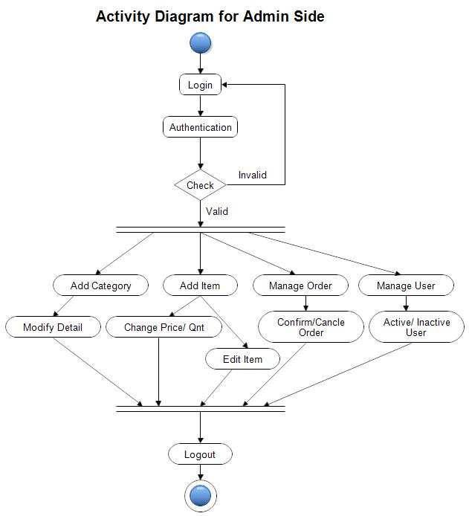
ER-Diagram [Admin Side]

Slide 13
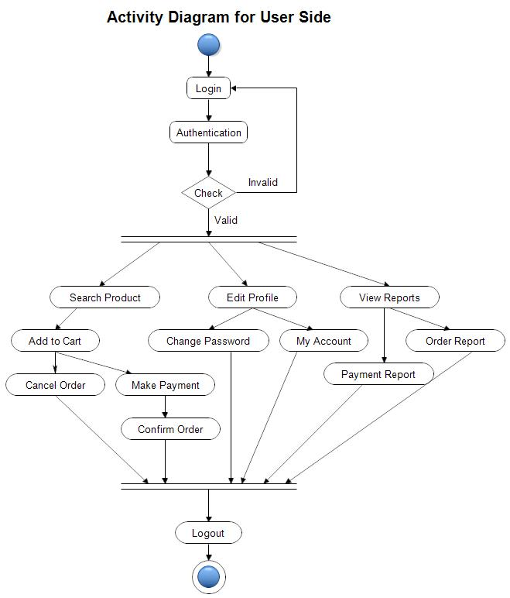
ER-Diagram [User Side]

Slide 14

Spring Dependencies Used :
spring-boot-starter-web
spring-boot-starter-jdbc
spring-boot-starter-data-jpa
ojdbc-8
spring-boot-starter-security
spring-boot-devtools

Slide 15
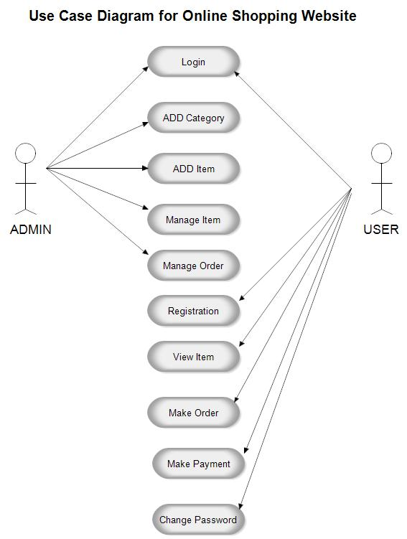
Use Case Diagram

Slide 16
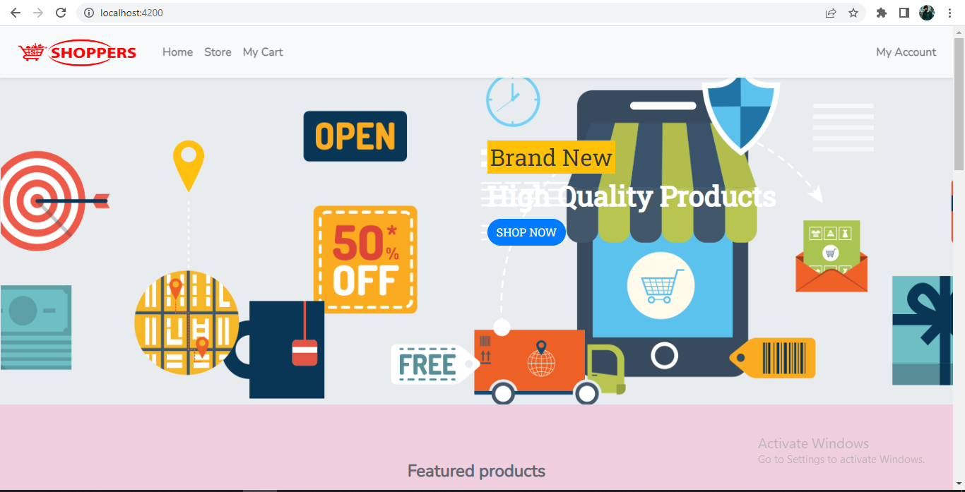
Home Page

Slide 17
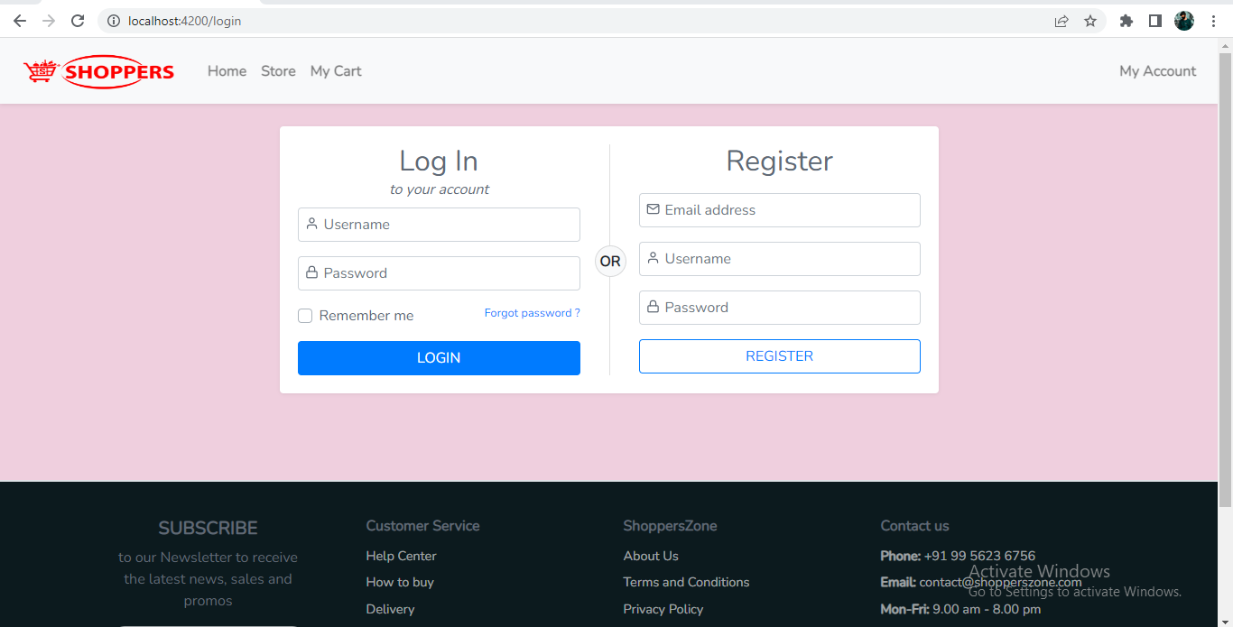
Login & Register

Slide 18
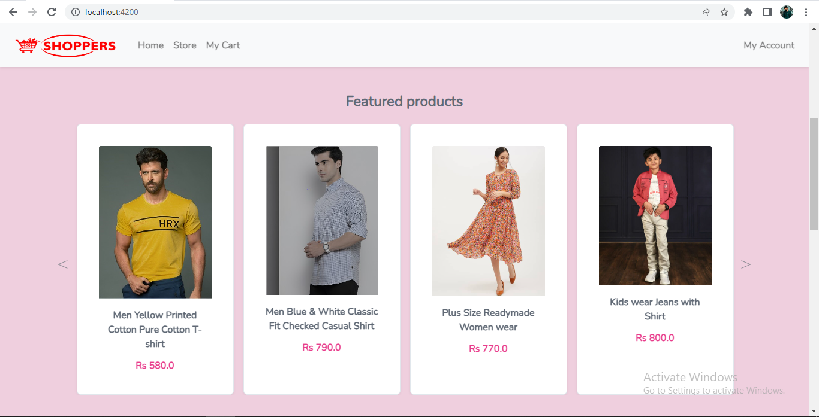
Featured Products

Slide 19
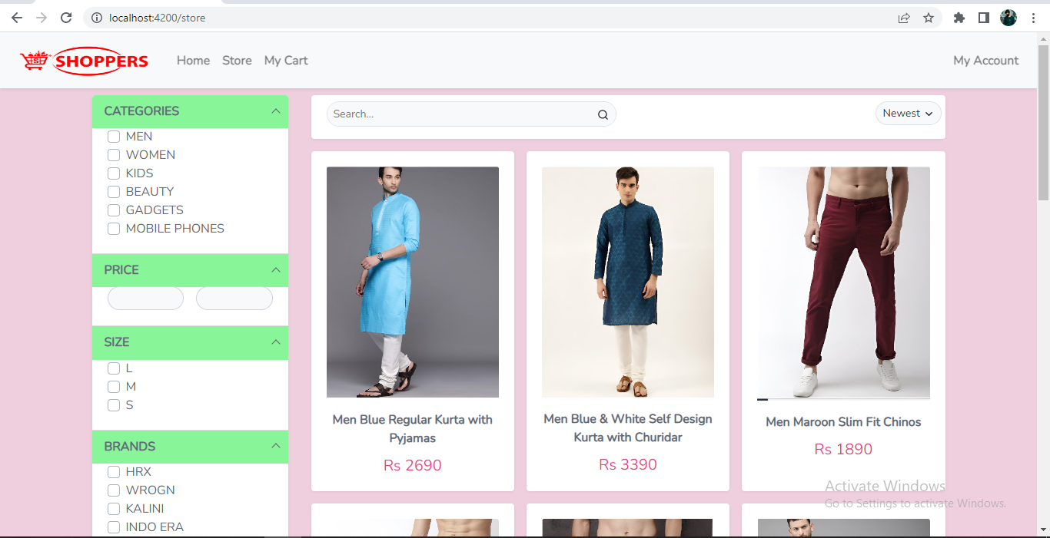
Store

Slide 20
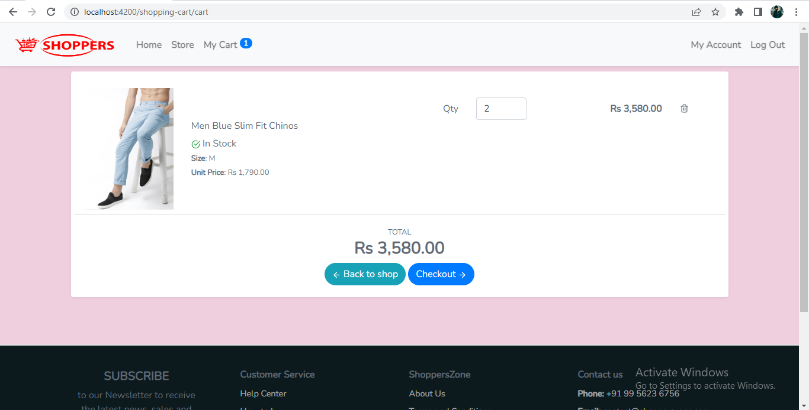
Cart Page

Slide 21
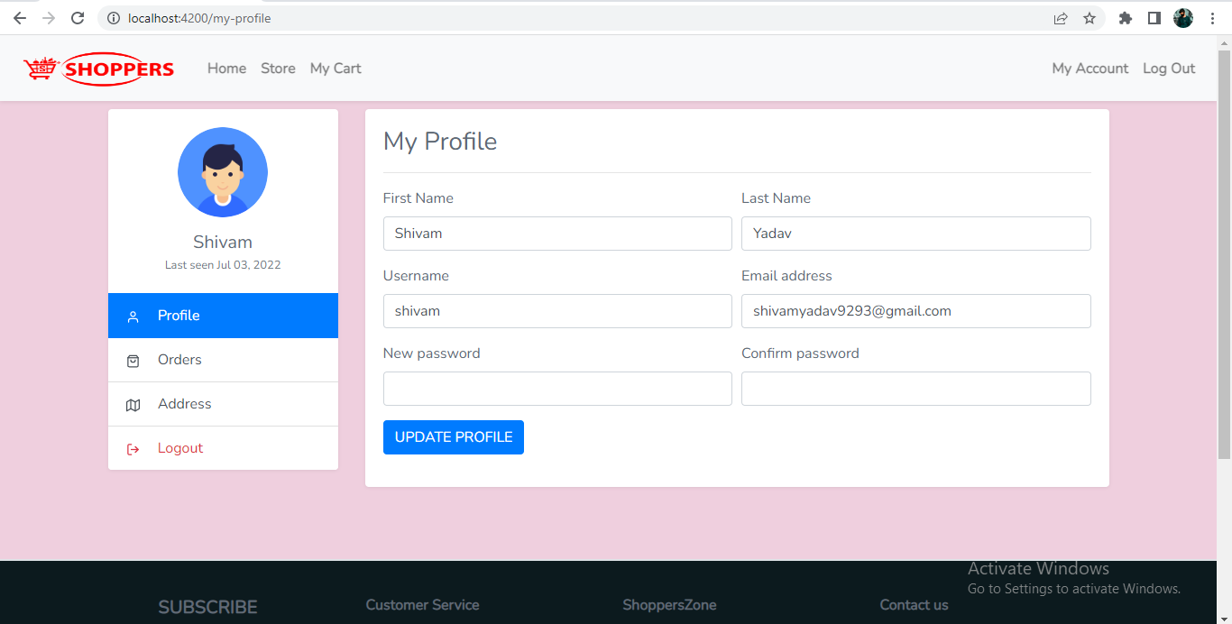
User Profile

Slide 22
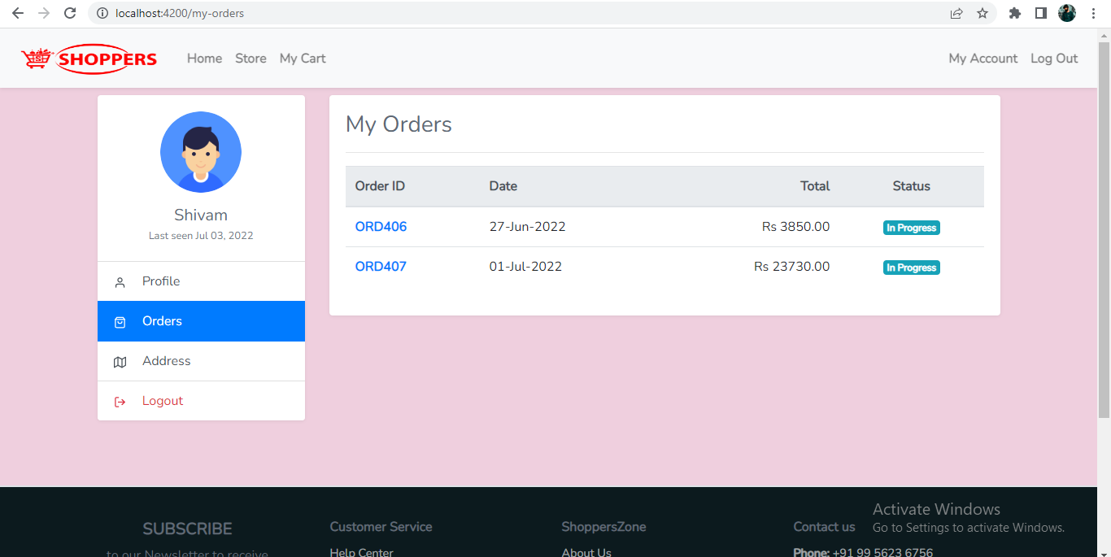
User Orders

Slide 23
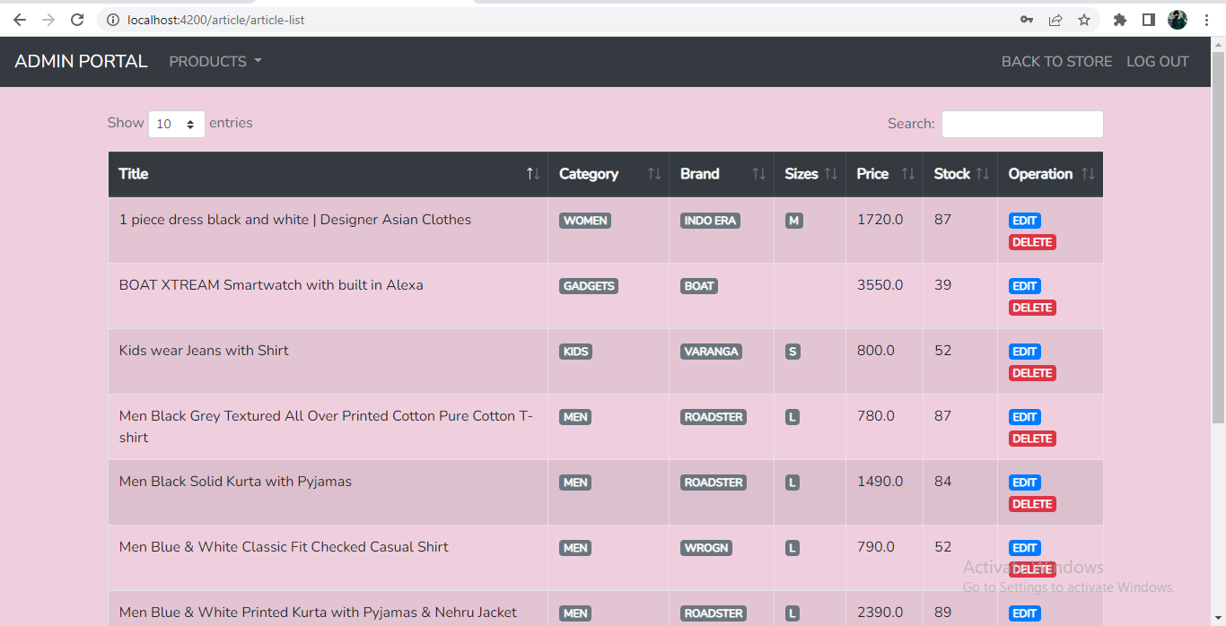
Admin Portal

Slide 24
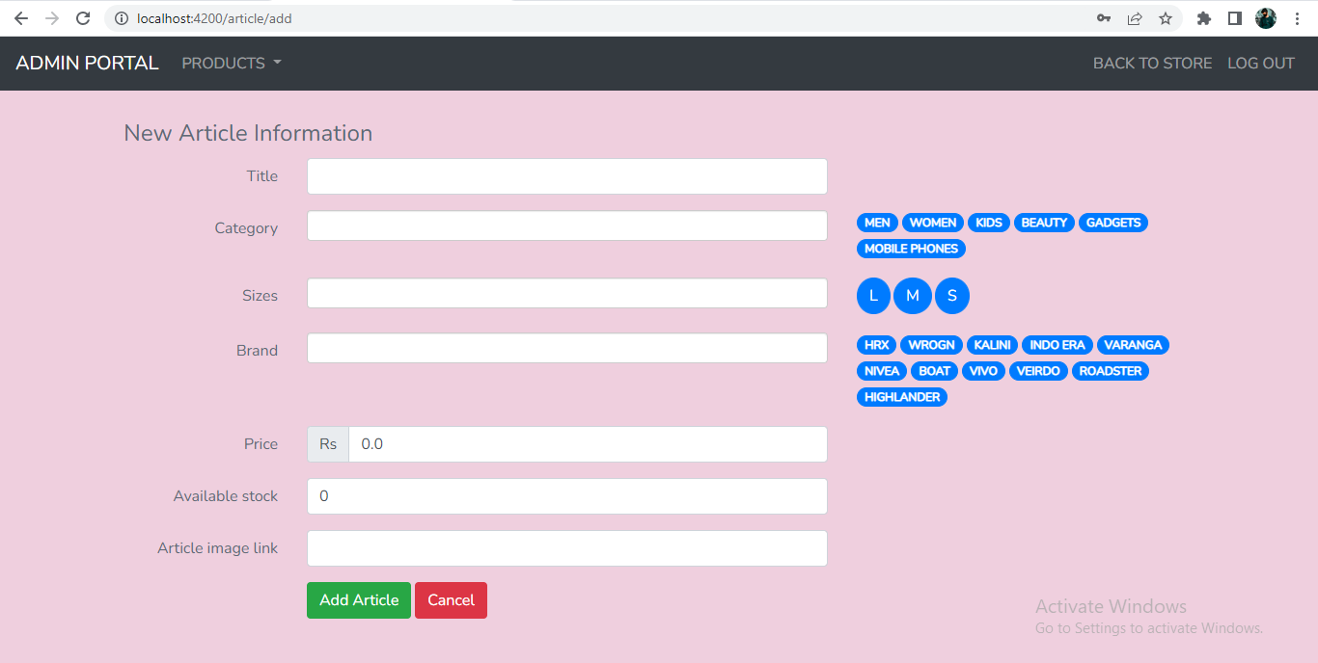
Admin Add Article

Slide 25
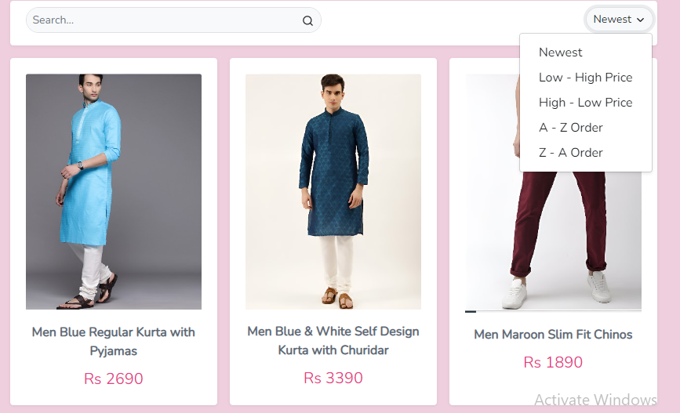
Sorting Articles

Slide 26
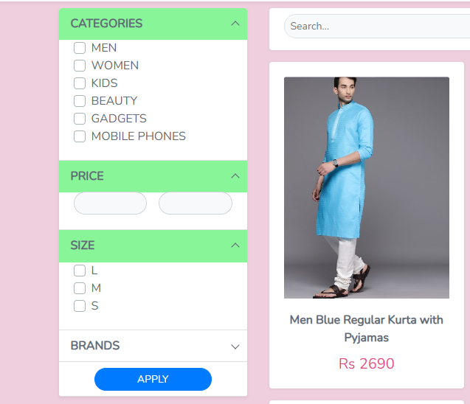
Sorting by Price, Category or Brand

Slide 27
Thank you Everyone ☺

